Slide 1
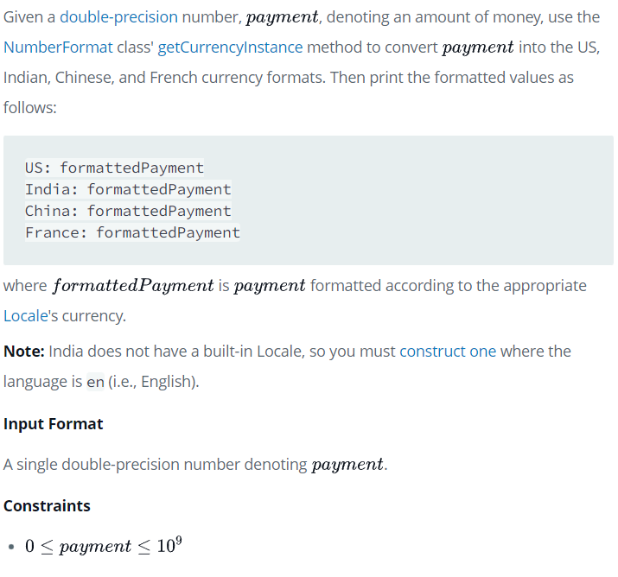
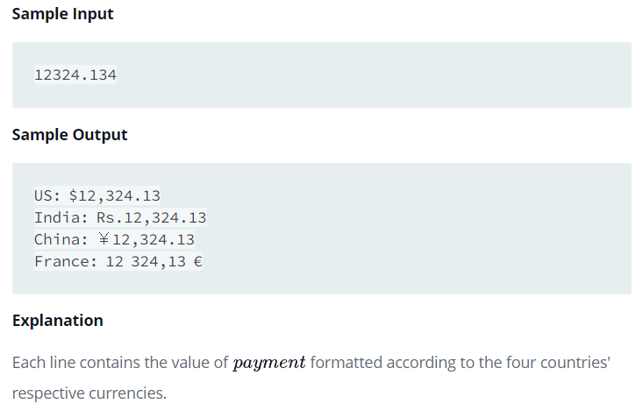
Problem 13th From HackerRank -Java Currency Formatter-

Slide 2
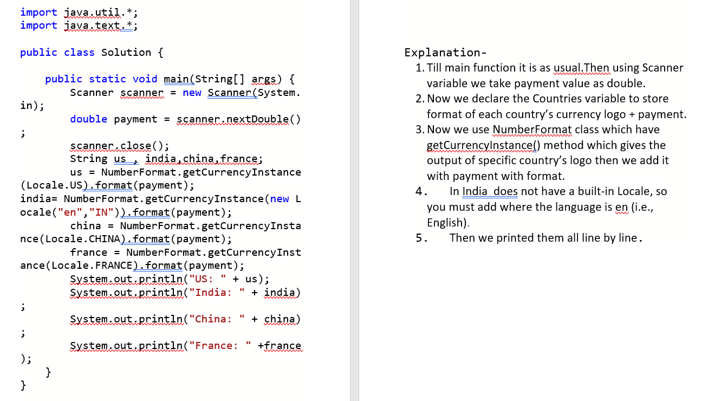
Solution 13th with Explanation

Slide 3
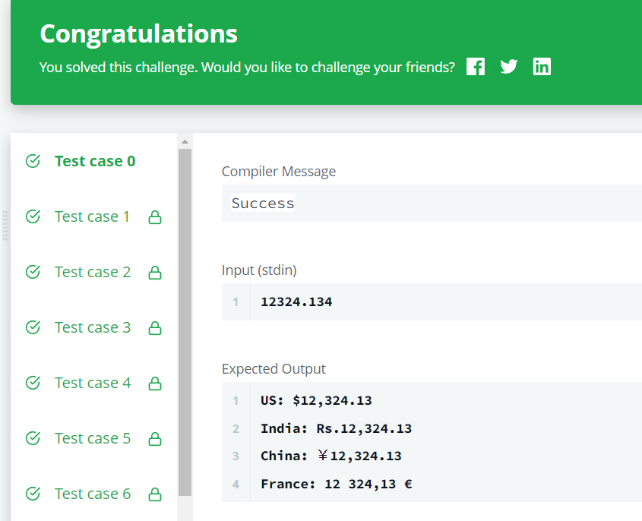
Output 13th-

